Slide 1

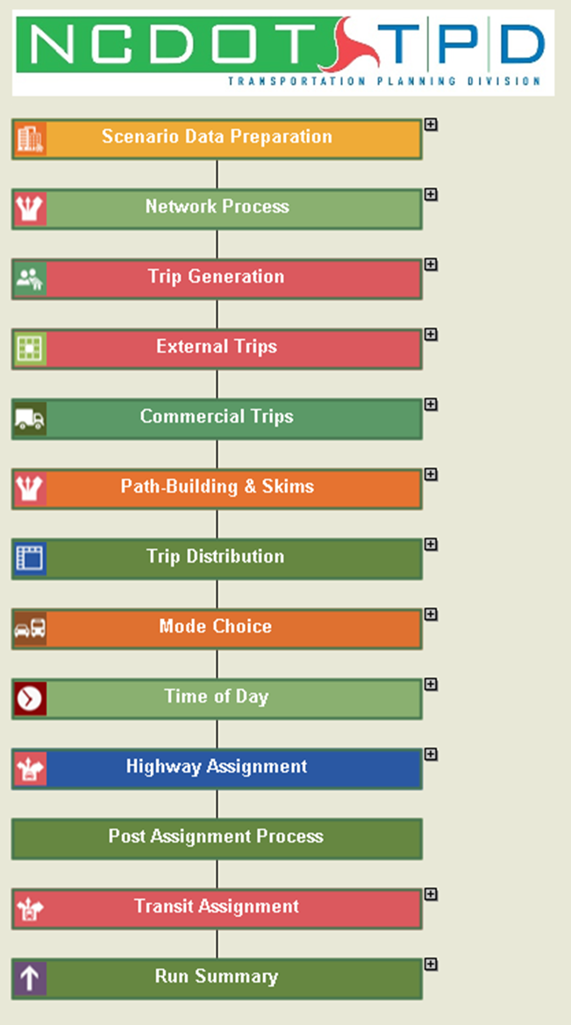


Regional Travel Demand Model Development

Slide 2
Presentation Overview
RTDM Development Program
  Objectives and Status
RTDM Development Program
  Objectives and Challenges
  CAV Model Methodology
  Visitor Model

Slide 3
RTDM Development Program
Objectives
  Standard Modeling Process for Regions under NCDOT Jurisdiction
  Model Structure Sensitive to Region Type
    MPO and Non-MPO
  Customized to Needs of Each Region
  Benefits
  Standard Structure Facilitates Staff Efficiency
  Transferability of Parameters and Routines
  Facilitate Transition to Advanced Features as Regions Grow

Slide 4
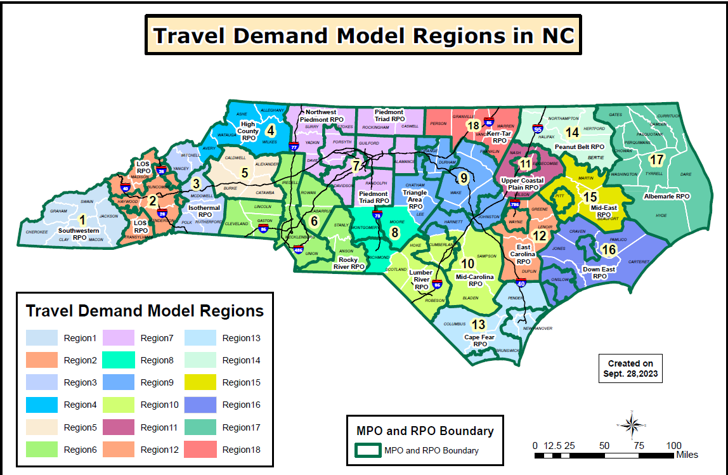
RTDM Development Program
Regions
  RTDMs for all Regions Except:
    Charlotte
    Raleigh
    Piedmont Triad
RTDM DEVELOPMENT

Slide 5
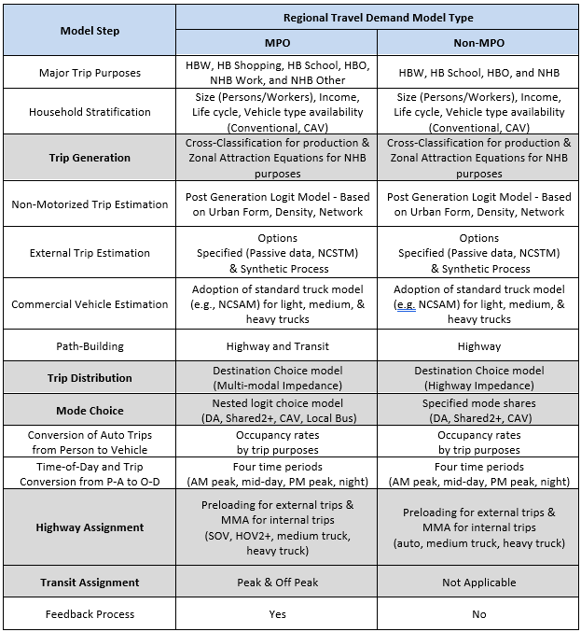
RTDM Types
Key Difference by Region Type
  Non-MPO:
    Four Trip Purposes
    Highway Only
  MPO:
    Six Trip Purposes
    Transit Included
    Feedback Processing
RTDM DEVELOPMENT
Model Can be Transitioned to MPO Type
  Future Year Testing
  Policy Evaluation

Slide 6
RTDMs – Plan of Implementation
RTDM Guidelines – General Methodology
Joint Effort – Stantec and NCDOT
  Stantec – Regions 17 and 16
  NCDOT – Region 1 and Region 18
Development Plan
  Implement Non-MPO model first, then MPO model
Status:
  Region 17 – Complete & Under Review
  Region 16 – Model Development Underway – Early 2024
  Region 1 – Model Development Underway
  Region 18 – Recently Initiated

Slide 7

Region 17 RTDM

Slide 8
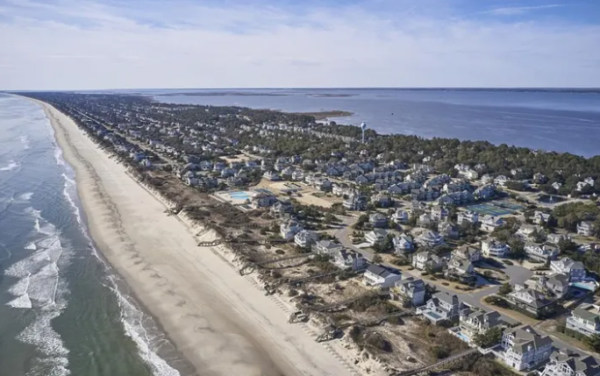
Region 17 RTDM – Overview
Key Characteristics
  Largely Rural
  Interaction with Large Attractors Outside of Region
  Significant Seasonal Travel
  Significant Seasonal Employment

Slide 9
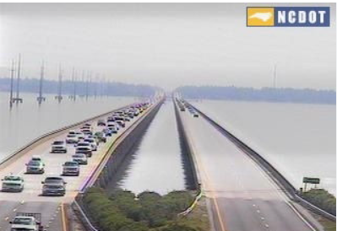
Modeling Challenges
Visitor Modeling
  NCDOT wanted Robust Visitor Model
  No Visitor Travel Survey Data
Resident and Visitor Travel Demand Interaction
Seasonal Employment impacts Resident Travel
Resident Travel Demand – AAWT Condition
April - Weekday
Visitor Travel Demand - Peak Condition
July - Saturday
  Multi-Condition Calibration
  Lack of Observed Data:
  Limited Information for Visitor Trips
    Limited Traffic Counts for Weekends
  No Information for CAVs

Slide 10
Modeling Challenges
Model Needs to be Predictive
  Sensitive to Potential Policies
  Emerging Travel Options
Limiting Model Complexity
  Potential Users
Model Assumes Evolving Improvement
  Data Driven Refinements
  Developer Controlled

Slide 11

Solutions
Visitor Model
  Segment Market into Key Demand Elements
  Seek Transferable Parameters
  Support Model Updates
CAV Model
  Balanced Modeling Approach
    CAV Fleet Penetration - Function of Costs
    CAV Impacts to Relevant Trip Types
    Developer / User Options
  Support Model Updates

Slide 12
CAV Model

Slide 13
CAV Model Methodology
Emerging Technology and Uncertain Travel Impacts
Scenario Modeling Approach
Assumptions & Professional Judgement
Developer Controls Certain Assumptions
  Reasonable Limits
  Refinements as Data Emerges
User Controls Main Assumptions & Likely Policy Variables
  Assumptions Allocated / Implement within Developer Controls
  Policy Variables / Socioeconomic Data / Network Improvements

Slide 14
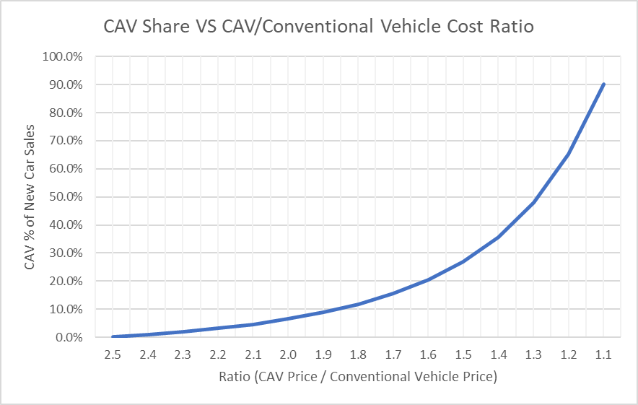
Developer & User Assumption Interaction
Developer Controls Assumption of CAV Share of New Car Sales
  Specify 3 Market Share Values and Model Generates Predictive Curve

Slide 15
Developer & User Assumption Interaction
User Specifies the Cost Ratio by Horizon Year
  CAV Share of Fleet Automatically Estimated for each Horizon Year

Slide 16
CAV Model - Key Features
Trips Generated by Household Type
  Conventional Vehicle Households (Exclusive)
  CAV Households (Likely mixed in early years)
Trips Estimated by Purpose
  Home-Based Work
  Home-Based Shop
  Home-Based Other
  Non-Home Based
Travel Modes Controlled by Household Type
Mobility Service Provider Mode (MSP) – (Driverless Uber, Lyft)

Slide 17
Mode Choice Assumptions
Varies by HH Type
  Indirectly Controls Generation of Zero Occupant Trips

Slide 18
CAV Model - Key Features
Zero Occupant Vehicles
  Added Trips or Replacement Trips – Varies by Purpose
  MSP movements between passengers – Varies by CAV Fleet Penetration
Selected Commercial Vehicles impacted by CAVs
  Light Truck Trips Reduced – Drone Service
  Medium & Heavy Trucks – Limited due to Commodity/Freight Type
Network Capacity and Speed influenced by CAVs
75% of Amazon Packages are less than 5 pounds.
90% of Americans Live within 10 miles of Walmart Store.
Network Capacity Increase is function of Travel Speed and Vehicle Spacing.
Adaptive Cruise Control Allows Driver to Select Spacing Distance.

Slide 19
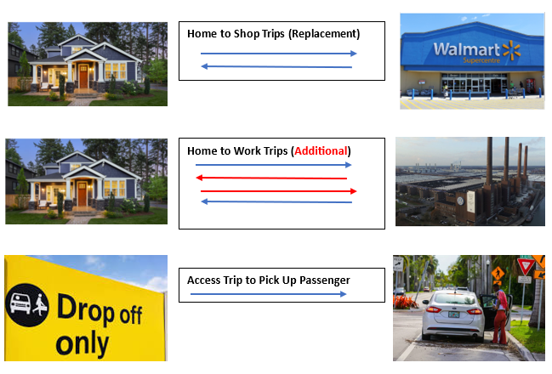
Zero Occupant Vehicle Trips
Generated by Privately-Owned CAVs and MSP CAVs
Limited to Certain Retail Types
Controlled by HBW Travel Time
Access Distance is Function of CAV Fleet Penetration

Slide 20
Mode Choice Times and Costs
Costs and Times are Different for MSP CAVs
  Costs also include zero occupant trips

Slide 21
Mode Choice Vehicle Costs
Costs are higher considerably for MSP CAVs
  Costs also influenced by zero occupant trips

Slide 22
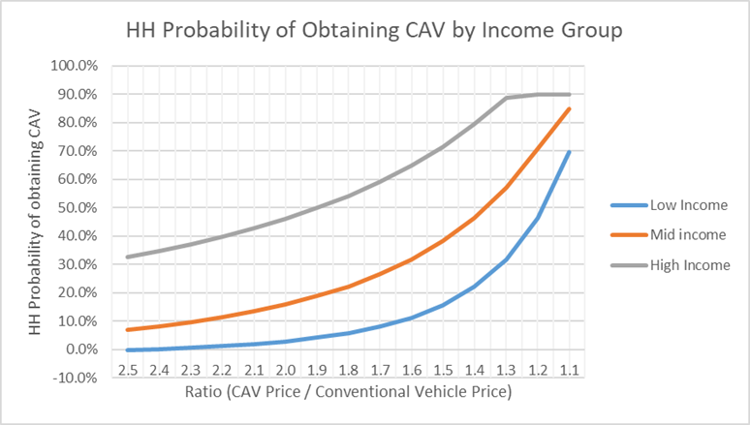
CAV Model - Key Features
Household Allocation
  Developer Routine allocates CAV Households into various subcategories
Trip Generation
  User provides assumed Trip Rate Change
  Developer Allocates Increased Trips into Household Types
Trip Distribution
  User provides assumed increases in Trip Distance for Selected Trip Purposes
  Developer Controls Eligible Trip Purposes and Upper Limits

Slide 23

Questions about CAV Model?

Slide 24
Visitor Model

Slide 25
Modeling Visitor Travel Demand
Issues
  Visitor Demand Generates Peak Demand Conditions
  NCDOT Not Satisfied with Basic Special Generator Methods
  Visitor Survey Data not Available
  Passive Data not Adequate
Conditions
  Peak Demand not Equal in all Regions
    Seasonal Peaks Vary
    Generators Vary
    Peak Day Types could Vary

Slide 26
Solutions
Segment Visitor Demand
  Trip Types
    Access Journey
    At-Location
  Traveler Types
    Day Trippers (Residents)
    Overnight Stay (Vacationers)
  Support Model Updates
    Flexible Framework
Source Data for Travel Characteristics
  1996 South Jersey Beach Travel Survey

Slide 27
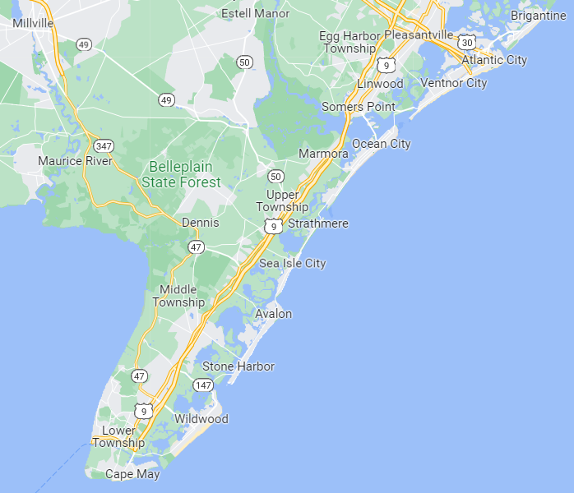
South Jersey Beach Survey - Data Issues
Applicability
  Pros:
    Large Rental Market
    Similar Travelers
    Similar Access Journeys
  Cons:
    South Jersey Town Density
    Different Activities (Casinos / Boardwalks)
    Survey Time Period (mid-1990s)
Availability
  Some Documents Available
  Source Data Discarded

Slide 28
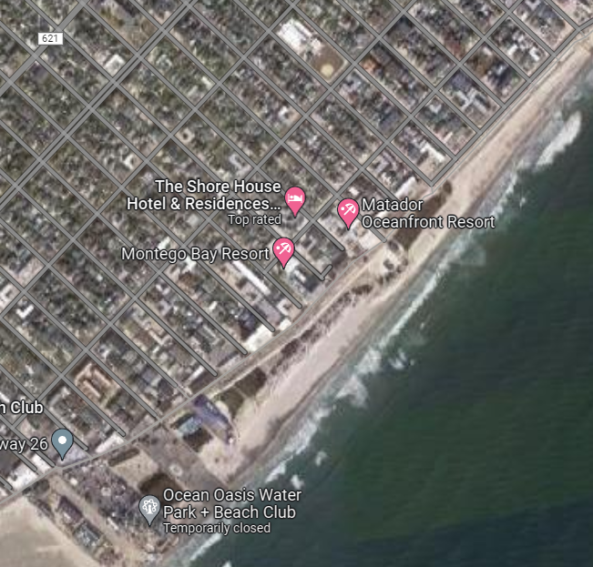
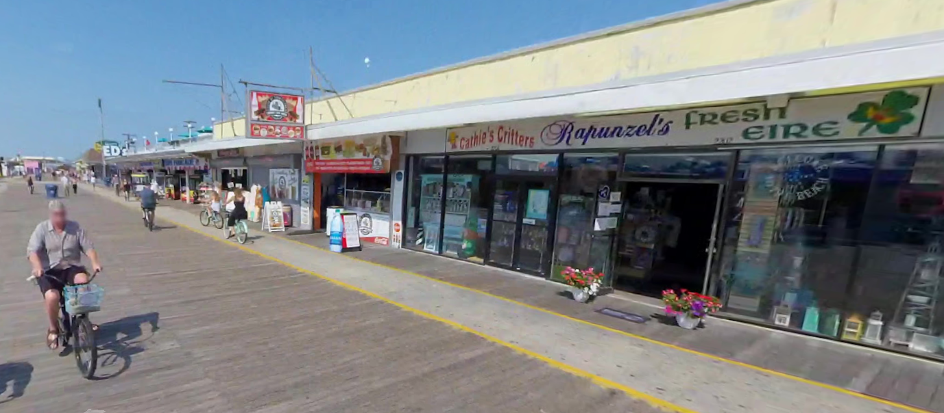

Survey Data Issues
Applicability
Pros:
Types of Trips are Common
To Beach / Eating / Shopping / Other
Predominately Auto Trips
Cons:
Higher Level of Non-Motorized trips
Different Activities (Casinos / Boardwalks)
Activities by Time-of-Day
Trip Length Likely Different

Slide 29
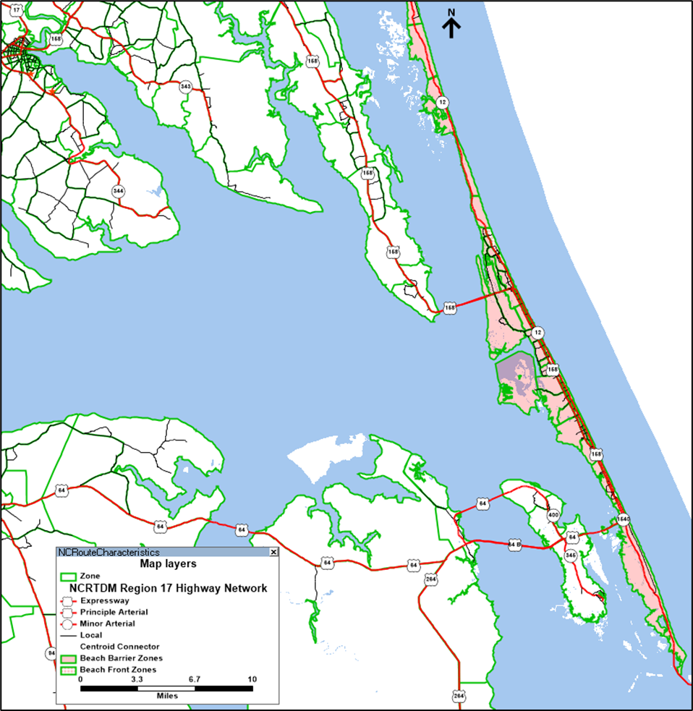
Market Segments
Visitor Types
  Long Distance Travelers on Vacation
    Multiple days
    Non-Residents of Region 17
  Local Residents – Mostly Recreational Travel
    Single days
    Region 17 Residents
Trip Types
  Access Journey Trips
    Vacationers
    Local Residents
  At-Location Trips
    Activities conducted at beach communities
RTDM DEVELOPMENT
RTDM DEVELOPMENT
29

Slide 30
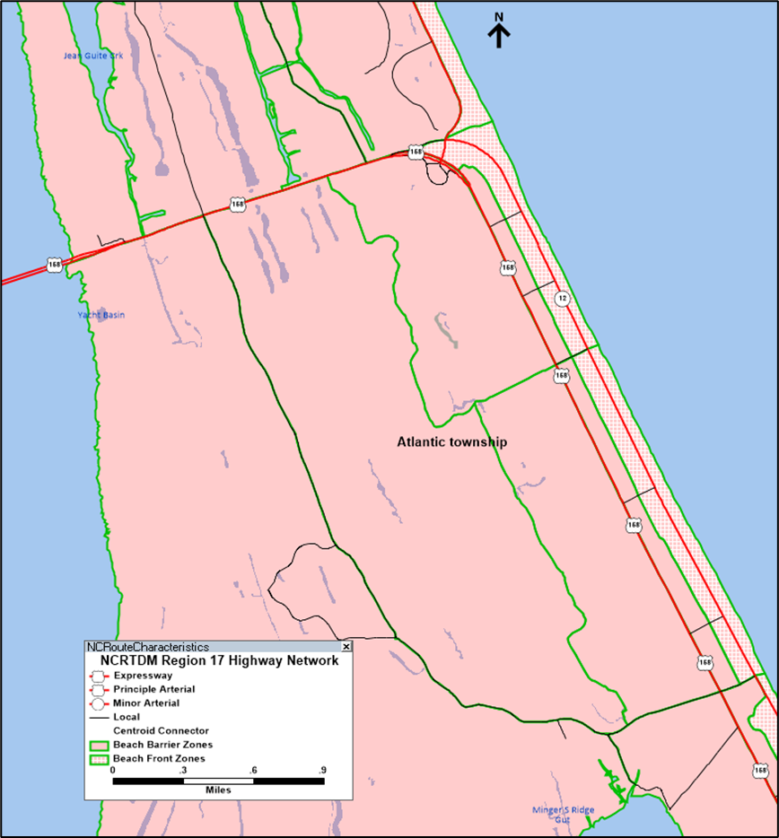
Visitor Trip Attraction Geography
Barrier Island Zones
Serves as attractors for access journey trips:
  Sole attractor of Overnight Stay Trips
  Partial attractor for Day Trips
Beach Zones & Key Attractions
Selected Beach Zones
  Primary attractor for Day-Trip access trips
  Used to limit beach-oriented vehicle trips from nearby zones.
Marinas, State & National Parks
  Secondary attractor for Day-Trip access trips
RTDM DEVELOPMENT
30
30

Slide 31
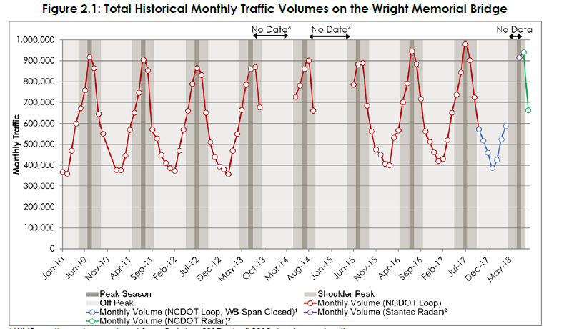
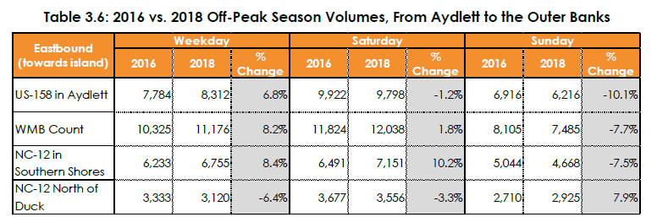
Source Materials
Initial Model Parameters
  1996 South Jersey Beach Visitor Survey
  Assumptions from Mid-Currituck Bridge Studies
Model Data
  Rental Bedroom Data
  Selected Types of Parking Spaces
Calibration Data
Key Intercept Points
  US 158 (Wright Memorial Bridge)
  US 64 (Baum Bridge)
Seasonal Count Data
  Extensive Count Program for MCB Studies
  NCDOT Counts in Barrier Islands
Passive Origin-Destination data from Streetlight
RTDM DEVELOPMENT
31

Slide 32
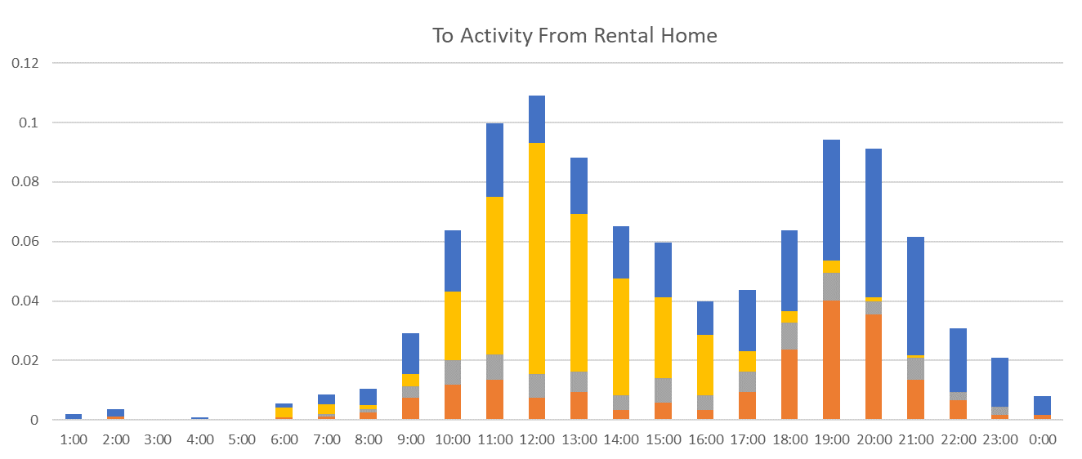
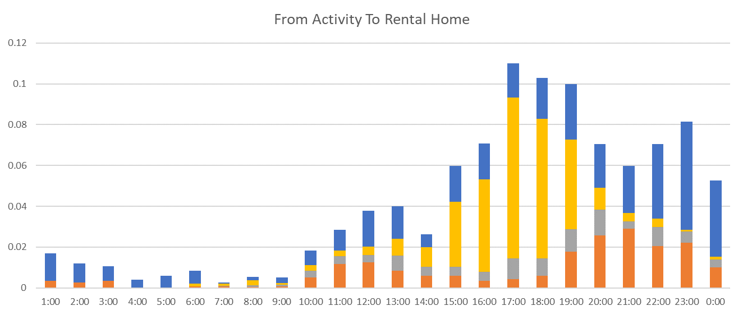
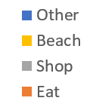
South Jersey Beach Survey - Time of Day Patterns by Trip Purpose
RTDM DEVELOPMENT
Legend
32

Slide 33
Visitor Model Structure
RTDM DEVELOPMENT
33

Slide 34

Visitor Model Elements
Putting the Pieces Together
Trip Purposes
  Access Journey Trips
  At-Location Trips
Zone System Requirements
  Geographic Descriptors
  Employment Stratification
  ‘Selected’ Parking Facilities
RTDM DEVELOPMENT
34

Slide 35
Trip Purposes – Access Journey
‘Access Journey’ Trips
  Estimated as Vehicle Trips
  Overnight-Stay:
    Produced at Selected External Stations (NC 168, US 17, US 64, US 264)
    Attracted to Rental Bedrooms (rental homes or hotel/motel)
  Day-Trip:
    Produced at Mainland Households in Region 17
    Attracted to Designated Beach Parking and Recreation Site Parking
  Access Journey trips applicable to Weekend Period (Saturday)
RTDM DEVELOPMENT
35

Slide 36
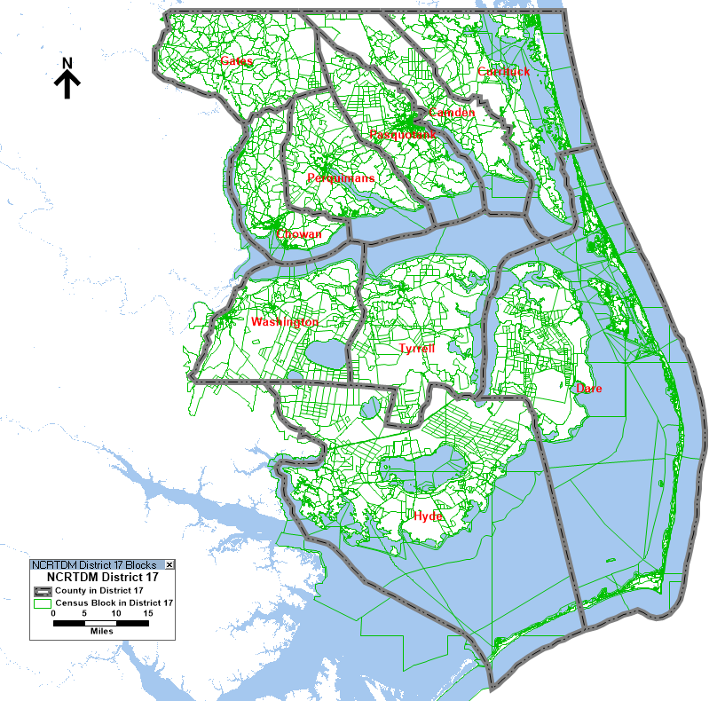



Overnight-Stay ‘Access-Journey’ Concept
Selected External Zones
Rental Bedroom *
17
RTDM DEVELOPMENT
64
264
Barrier Island Zones
Access Journey Trips (includes Return Trips)
* Includes Hotels & Motels
36

Slide 37



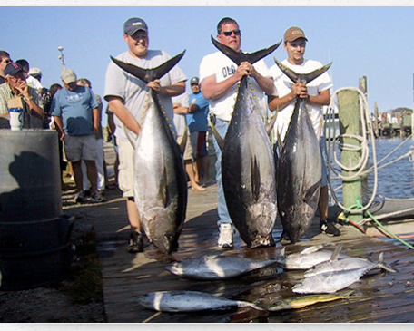
Day-Trip ‘Access-Journey’ Concept
Key Assumptions:
Only Mainland Residents of Region 17 make day trips
Attractions are Primarily Recreation Locations
Primary Recreational Locations *
RTDM DEVELOPMENT
Barrier Island Zones
Access Journey Trips (includes Return Trips)
37

Slide 38
Trip Purposes – At Location
‘At-Location’ Trips
  Estimated as Motorized Person Trips
  Function of Family Life Cycle
  Overnight-Stay:
    Some Produced at Rental Bedrooms (similar to home-based purposes)
    Some Produced at Other Locations (similar to nonhome-based purposes)
  Day-Trip:
    Some Produced at Designated Recreational Activity Sites (from Access Journey)
    Some Produced at Other Locations
  At-Location Trips - Applicable Day of Week Periods:
    Saturday - Both Overnight-Stay & Day-Trip Market Segments, But Reduced Scale for Overnight-Stay
    Wednesday - Overnight-Stay Only, No Midweek Day Trips Assumed
RTDM DEVELOPMENT
38

Slide 39
‘At Location’ Trip Purposes
‘At-Location’ Trips
  Key Recreational Activities
    Eat
    Shop
    Beach
    Other
  These Trips are Produced at Two Types of ‘Sites’:
    Primary:
      Vacation Dwelling Unit (Overnight Stays)
      Selected Beachfront Zones (Day Trips)
    Secondary:
      Employment or Recreational Sites
RTDM DEVELOPMENT
39

Slide 40




Overnight Stay ‘At-Location” Trip Examples
Rental Bedroom *
At Location – Shop
Cross-Classification Trip Rate Table
RTDM DEVELOPMENT
National Parks & Fishing Piers are examples of ‘At Location-Other’ trips
At Location - Beach
At Location - Eat
Vacation Dwelling Unit Based
Other Location Based
40
* Includes Hotels & Motels

Slide 41
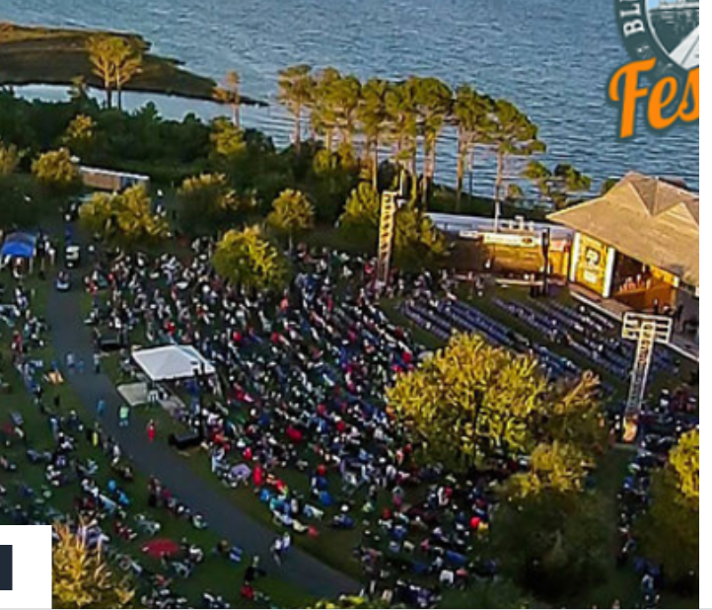

Day-Trip ‘At-Location’ Trip Examples
At Location – Other
Beach Zone with Public Parking
At Location – Other
RTDM DEVELOPMENT
At Location - Beach
At Location - Eat
Arrival Zone Activity (Beach, Recreation, Marina)
Other Location Based
National Parks & Fishing Piers, and other entertainment are examples of ‘At Location-Other’ trips
41

Slide 42
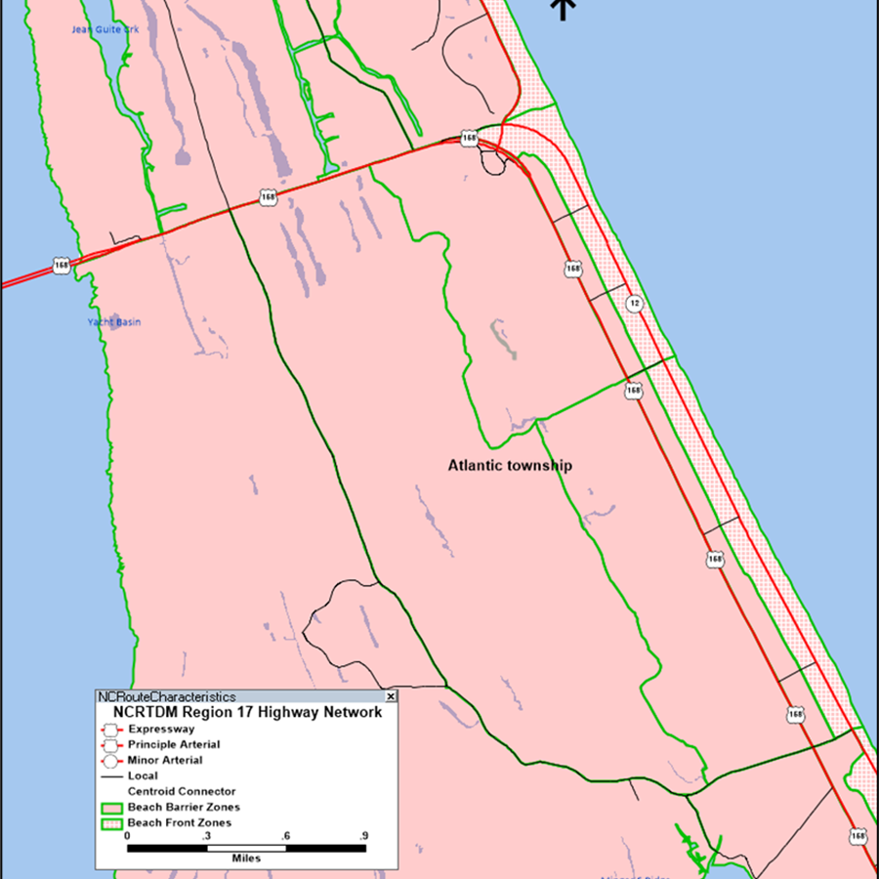
Beach Communities
Zonal Designations
Barrier Island Zones – any zone that is on a Barrier Island
Barrier Island Accessible zone – Any zone with 10 highway miles of a Barrier Island Zone
Beachfront Zones – zones with beachfront
Primary Model Function
Barrier Island Zones
  Attractors for Overnight Stay Access Journey trips
  Trip Generation for all At-Location trips
Barrier Island Accessible Zone - Attractors for nearby mainland tourist attractions (golf courses, water parks, etc.)
Beachfront Zones – Attractors for resident day-trips, and NHB trips, if parking available.
RTDM DEVELOPMENT
42

Slide 43
Employment Classification Refinements
Revised Classifications
  Industrial
  Retail
  Highway Retail
  Restaurant
  Service – Weekdays
  Service – All Days
  Office
RTDM DEVELOPMENT
43

Slide 44
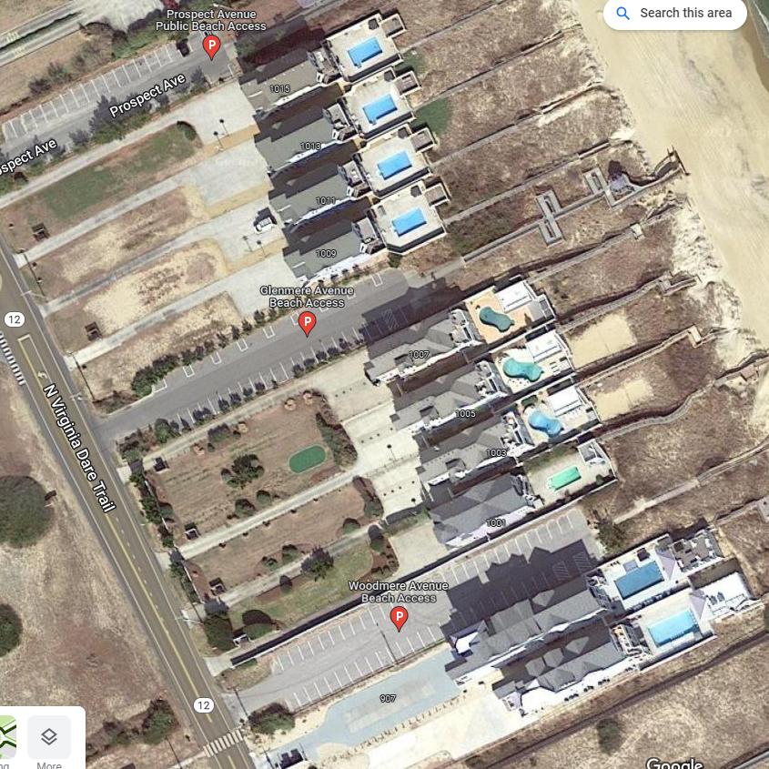
Parking Data Requirements
Designated Beachfront Zones
Attractor for ‘Day-Trip’ Access trips
Number of spaces is attractor variable
Most Shore Towns have provided multiple locations
Also used as attractor for ‘At-Location’ Beach trips
State Parks/National Parks & 4WD areas
Attractor for ‘Day-Trip’ Access trips
Available spaces estimated by judgement
RTDM DEVELOPMENT
44

Slide 45
Application by Season & Day of Week
RTDM DEVELOPMENT
45

Slide 46
Execution Structure & Concepts
Execution Process
Execution Controlled by Month and Day Type
  April/July – Weekday/Weekend
Data and Parameters Adjusted for Specified Condition
  Scaling of zonal data
  Scaling of parameters
Visitor Model
  Executed only in Iteration 1
  Requires Highway Skim Processing
  Provides Vehicle Trips for Highway Assignment
Visitor Model Processing
At-Location Trips have sequential processing:
  Primary Trips Originate at Vacation Dwelling units or Specified Production zones
  Subsequent (NHB) trips utilize Primary Trip Destinations as controlling productions
Select Season & Day
Adjust Data & Parameters
Highway Paths & Skims
Resident Model
Trip Generation
Trip Distribution
Mode Choice
Visitor Model
Trip Generation
Trip Distribution
Mode Choice
RTDM DEVELOPMENT
Highway Assignment
Convergence Testing

Slide 47
Application Concept
The Visitor Model works in a coordinated process with the Resident Model.
Seasonal Scaling
Visitor Model
  Scales occupied rental bedrooms. This controls ‘Access Journey’ Trips and ‘At-location’ trips for overnight-stay market segment.
  Scales parking availability for Day Trips. This controls ‘Access Journey’ Trips and ‘At-location’ trips for day-trip market segment.
Resident Model
  Scales seasonal employment ‘layer’ This controls the amount of added employment and proportionally increases HBW trip productions to match change in employment.
  Potential adjustments to Nonwork purposes. Example, HB School purpose not active in Summer
Day-of-Week Selection
Visitor Model
  Enables or Disables Access Journey Trips & Day-Trip market segment
Resident Model
  Enables or Disables weekday only employment
  Scales the HBW productions as necessary, alters the magnitude of HBW trips
Time-of-Day Pattern
Visitor Model
  Enables or Disables Access Journey Trips & Day-Trip market segment
April – Wednesday
July - Saturday
RTDM DEVELOPMENT
47

Slide 48
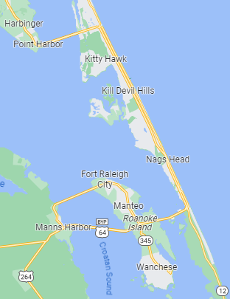
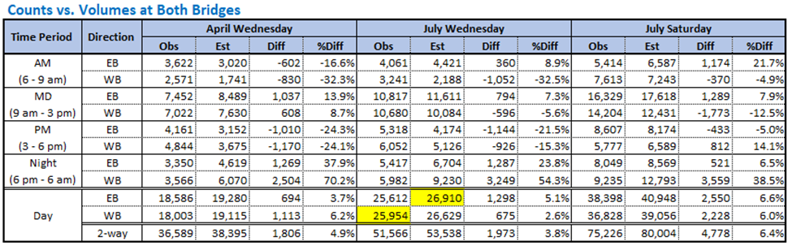
Proof of Concept – Barrier Island Bridge Intercept
Multi-Condition Calibration
  AAWT – April Wednesday
  Peak Demand – July Saturday
Observed Volumes and Directional Patterns
Combination of Resident and Visitor Trips
Saturday includes:
  Visitor Access Journey & At Location Trips
  Resident Trips Modified by Month and Day Type
  Impacts Trip Magnitude, Purpose & Time of Day Patterns
RTDM DEVELOPMENT
48

Slide 49
Questions?

